Slide 1


SDP
LECTURE
The Decorator Design Pattern
Software Design Patterns
Diploma in IT
Year 2 (2024/25), Semester 4
5.1
Notes:
Hi everyone! Since this week is white space week, we are going to take it easy and only introduce one design pattern, which is the decorator design pattern. Let’s see how this one works.

Slide 2
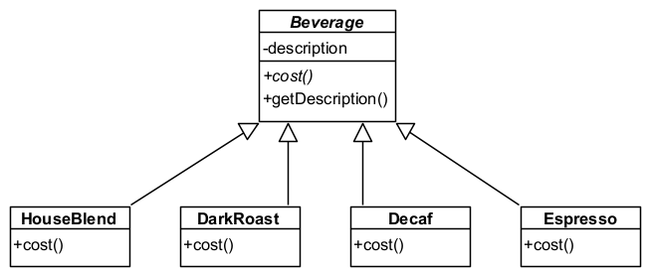
Example Problem – Starbuzz
Starbuzz serves a variety of freshly brewed coffee
Initial class diagram:
Notes:
So there’s this chain of coffee shops called Starbuzz that sells snazzy coffee that appeals to hipsters. It’s not like the kopitiam kopi o kosong type, but more like the fancy double skinny cappuccino with nutmeg and extra foam, you know what I mean. We are designing a system that handles coffee orders for Starbuzz.
|| Here is the initial class diagram for the system. We have an abstract class called || Beverage that contains a description string, and the getDescription() method returns that string. The Beverage class has an abstract method cost(), so all of its subclasses must implement its own version of cost(). In this current diagram, we have 4 different types of Beverages, namely HouseBlend, DarkRoast, Decaf and Espresso. The cost() method for each of these classes will return the cost of that coffee, so maybe HouseBlend returns $4.50 while DarkRoast returns $4.00. This system design is quite reasonable, and leaves open the possibility of adding new beverages such as other coffees or even tea.

Slide 3

Example Problem - Starbuzz
Starbuzz coffees have different condiments
E.g., steamed milk, whipped cream, mocha, cinnamon
Each condiment adds to the cost of the coffee
How do we implement this?
Notes:
Of course, part of the fun of drinking coffee is all of the customization options. For example, we could add things like steamed milk, whipped cream, mocha or cinnamon so that it looks better on Instagram. Starbuzz calls these condiments, and each condiment adds a bit to the cost of the coffee. They definitely plan to add more condiments in the future, so the system design should be able to gracefully handle new condiments. So, how should we implement this?

Slide 4
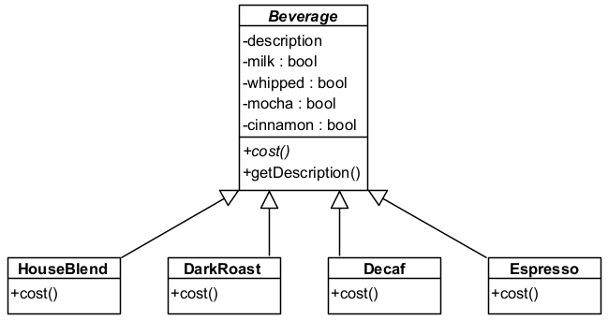
First Attempt
Let’s just use member attributes in the Beverage class to keep track of condiments
Calculates the cost
for condiments
Calculates the cost
for the coffee + base.cost()
Notes:
One way we could do this is to use member attributes to keep track of all the condiments, like this. Suppose we currently have 4 different condiments, we could add || 4 Boolean member attributes into the Beverage class that keeps track of whether the beverage has that condiment. The || cost() method in Beverage can calculate the total cost of all the condiments, although it will then no longer be an abstract method. We can then cleverly have each || cost() method of the subclasses take the base cost, add the cost of the coffee and return the result. This doesn’t look too bad and will work in the short term, but there are some issues to this design.

Slide 5
Potential Problems
Price changes to condiments will require a change in the code for the cost() method in Beverage
Adding new condiments will also require a change in the cost() method in Beverage
All new subclasses (such as Tea) will inherit everything from Beverage (such as whipped)
What if someone wants double mocha?
Notes:
Here are some potential problems. Notice that the total cost of the condiments is calculated in the Beverage class, which means that || if the price for a condiment changes, we have to change the code inside the Beverage class. This should be a red flag since we don’t want Beverage to have to change when a condiment changes, as that is a sign of poor class cohesion. Similarly, || adding a new condiment will also require us to recode the cost() method in Beverage. Assuming condiments change but the Beverage class should stay the same, then our principle of encapsulating what changes tells us that we should probably separate condiments from the Beverage class.
Having condiment information in the Beverage class may potentially introduce || poor specialization cohesion in the future, because not all condiments are applicable for all beverages. For example, if we add a new Tea subclass, it will inherit everything from the Beverage class. I don’t know about you, but I’m not likely to want whipped cream in my tea. Finally, this design using Boolean attributes can’t handle if someone wants || more than one instance of a condiment, such as a coffee with double mocha. Sure, we can resolve this by using an integer instead, but that solution is a little awkward. So, can we do better?

Slide 6
Let’s Apply a Design Principle
Principle: The “Open-Closed” Principle
Classes should be open for extension, but
closed for modification
We want to allow code to be easily extended to incorporate new behaviour without modifying existing code
Our previous principles of “encapsulating what changes” and “composition is better than inheritance” can help us achieve this
Notes:
It’s time for another OO design principle! This principle is called the || “Open-Closed” Principle, which says that classes should be open for extension, but closed for modification. What does this mean? Well, we want to be able to || extend our code easily, especially for things that we know will frequently change, such as new condiment or beverage types. However, when we do extend our code, we want to make sure that we minimize the necessity of modify existing code.
OK, that sounds good, but how do we achieve this? Unfortunately, there isn’t a magic formula for this, but it should come about when we apply sound OO design principles such as || encapsulating what changes and favouring composition over inheritance. In fact, we have been applying the open-closed principle all this time. For example, the observer pattern allowed us to extend our system by adding new observers and subjects without having to modify existing objects. For the Starbuzz problem, there is a design pattern that fits our needs and adheres to the open-closed principle.

Slide 7
The Decorator Pattern
E.g., a customer orders a Dark Roast with mocha and whipped cream
What we do:
Create a DarkRoast object
Decorate it with a Mocha object
Decorate it with a Whipped object
Call the cost() method and rely on delegation to add the condiment costs
What do we mean by “decorate”?
Notes:
The pattern we can apply is called the Decorator design pattern. Let me give you an intuition of how the Decorator pattern works. || Suppose a customer at Starbuzz orders a Dark Roast coffee with mocha and whipped cream. If we are using the decorator pattern, we would || first create a DarkRoast object as usual. Each of the condiments will be represented by a separate class, so we would have the Mocha and Whipped classes to represent the mocha and whipped cream condiments. So we can now || decorate the DarkRoast object with a Mocha object, and then decorate the resulting objects with a Whipped object. After that, we will || call the cost() method of the resulting object, which will calculate the final cost of the coffee by recursively calling the cost() methods of all the involved objects. So, what do we mean by || decorate? Let me try to explain with an illustration.

Slide 8
Dark Roast with Mocha and Whip
1) Call cost() on Whipped
2) Whipped calls cost() on Mocha
cost()
Whipped
6) Whipped adds its cost, 50 cents, to the result from Mocha and returns $5.30
3) Mocha calls cost() on DarkRoast
cost()
Mocha
cost()
DarkRoast
5.30
4.80
5) Mocha adds its cost, 80 cents, to the result from DarkRoast and returns $4.80
4.00
4) DarkRoast returns its cost, $4.00
Notes:
To create an object representing a Dark Roast coffee with mocha and whipped cream using the decorator pattern, we first create a || DarkRoast object. Since DarkRoast is a type of Beverage and all Beverages have a cost() method, so DarkRoast will implement its own cost() method. Next, we add || mocha to the Dark Roast by creating a Mocha object and essentially wrapping the DarkRoast object in it, and we call this decorating. Importantly, the Mocha object is also a subclass of Beverage, so the Mocha object with the DarkRoast in it also has a cost() method. Similarly, we add || whipped cream by decorating the Mocha object with a Whipped object, so the Whipped contains the Mocha which contains the DarkRoast.
Now, how do we calculate the cost of the DarkRoast coffee with mocha and whipped cream? All we need to do is || call the cost() method of the Whipped object. This method will call the || cost() method of the Mocha object it is decorating to find out its cost. When that happens, the Mocha object will || likewise call the cost() method of the DarkRoast object it is decorating. Since the DarkRoast object is a coffee and not a condiment, its cost() method will simply || return the cost of DarkRoast coffee, which is $4.00. The Mocha object gets this value, adds to it the cost of mocha which is 80 cents, and || returns the total of $4.80. Finally, the Whipped object receives this value, adds its own whipped cream cost of 50 cents, and || returns the total of $5.30. Not too bad for a yummy dark roast coffee with mocha and whipped cream, right?

Slide 9
The Decorator Pattern
Decorators have the same supertype as the objects they decorate
We can use the decorated object in place of the original (wrapped) object
The decorator adds its own behaviour and/or after delegating to the object it decorates to do the rest of the task
You can use one or more decorators to wrap an object
Decorators can be added at runtime
Notes:
So that was the overall concept of the decorator pattern. Here are a few things to pay attention to. Note that decorators have || the same supertype as the objects they decorate. In our example, condiments are subclasses of beverages. This is so that a decorated object is the same type as the original object and can be used in the same way, so coffees with condiments can be treated the same way as plain coffees. The purpose of adding a decorator is to || add new behaviour to the object it decorates that is in addition to the object’s original behaviour. In our example, condiments add to the cost of the base coffee. The decorator pattern allows you to || use multiple decorators to wrap a single object, so you can add multiple new behaviours to one object. Finally, decorators || can be added at runtime, which adds significant flexibility.

Slide 10
The Decorator Pattern
Notes:
So that was the informal example. Here is the formal definition of the Decorator design pattern.

Slide 11
Definition
The Decorator Pattern:
Attaches additional responsibilities to an object dynamically.
Decorators provide a flexible alternative to subclassing for extending functionality.
Also known as
Wrapper
Notes:
The Decorator Pattern attaches additional responsibilities or functionalities to an object dynamically, and this can be done during run-time. In OO programming, in order to add functionality to a class, we often create a subclass and put the new functionalities in the subclass. Instead of doing this, you can think of the decorator pattern as a flexible alternative to subclassing for extending the functionality of a base class object. This pattern is also known as || the Wrapper pattern.

Slide 12
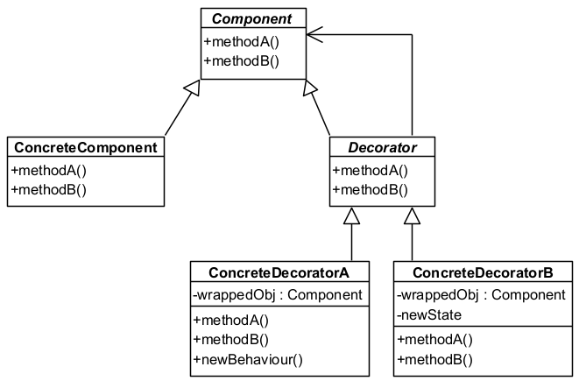
The Decorator Pattern
Each Decorator HAS-A (wraps) a component
Decorators can add new states
Decorators can add new behaviours
Notes:
This is the class diagram for the decorator pattern. We have an || abstract class called Component, which is the base object that we want to add functionality to and specifies methods that must be implemented. We have || ConcreteComponents that inherit from Component and implements all the required methods. In addition, we have another abstract class called || Decorator. Note that Decorator || inherits from Component, so it is a Component. In addition, it also || has a reference to another Component, which is the Component that it is decorating or wrapping. Since Decorator is an abstract class, it must have subclasses. || These subclasses are called ConcreteDecorators, which implement new functionalities. These functionalities could be in the form of || new states, which is new information maintained by the object. It could also be in the form of || new methods that implement new behaviours.

Slide 13
Key Participants
Component
Defines the interface for objects that can have responsibilities added to them dynamically
ConcreteComponent
Defines an object to which additional responsibilities can be attached
Decorator
Maintains a reference to a Component object
Defines an interface that conforms to the Component
ConcreteDecorator
Adds responsibilities to the component
Notes:
Therefore, the Decorator pattern has 4 key participants. The || Component defines an interface that objects to be decorated must follow.
|| All such objects must inherit from Component, and these are called ConcreteComponents. ConcreteComponents define specific implementations of all the methods given in the Component class.
A || Decorator is also a subclass of Component, but is itself an abstract class. The Decorator maintains a reference to the Component object that it is decorating, and its interface corresponds to what the Component requires.
Finally, a || ConcreteDecorator inherits from Decorator and adds new responsibilities or functionalities. In particular, it will call the functionality of the component it is decorating, and then add something more.

Slide 14
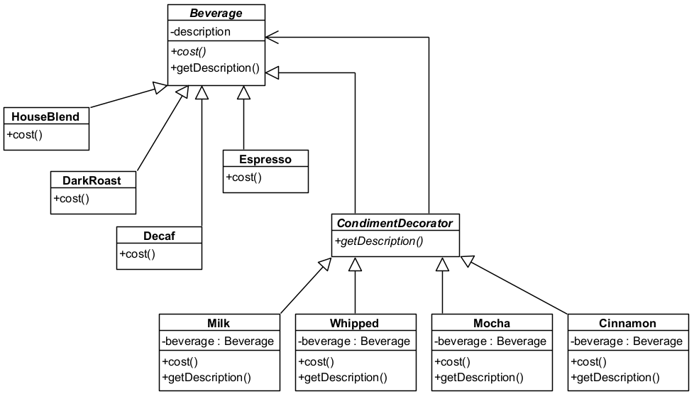
Applying Decorator to Starbuzz
Component
ConcreteComponents
Decorator
ConcreteDecorator
Notes:
Let’s apply the Decorator pattern to our Starbuzz application. We have the abstract class Beverage, which is our || Component. Beverage has a description attribute, an abstract operation cost() which must be overwritten by its subclasses, and an operation getDescription() that simply returns the description attribute as a string. All of our different types of coffee such as HouseBlend or DarkRoast are || subclasses of Beverage, and these are our ConcreteComponents, and they all have to implement their own version of the cost() method. Now for the cool bit. We have another abstract class || CondimentDecorator that also inherits from Beverage, so CondimentDecorator is a Beverage. This is the Decorator. Notice that CondimentDecorator has a || reference to a Beverage, which is what it is decorating. Not only that, we declare an abstract method getDescription() that will be implemented by its subclasses. Finally, all of our condiments such as milk or whipped cream are || separate classes that inherit from Decorator, and these are our ConcreteDecorators. They each also have an attribute of type beverage, which refers to what it is wrapping. Each condiment class will implement their own cost() method, which adds their own price to the price of whatever they are wrapping. Furthermore, they will have their own version of getDescription() that will return a string containing not only the name of the base coffee but also all the condiments in the coffee. Let’s see how we can code this in C#, shall we?
OK, this may be a bit confusing, so let’s take a look at how we would code this in C#.

Slide 15
Implementation
public abstract class Beverage {
protected string description = "Unknown Beverage”;
public virtual string getDescription() {
return description;
}
public abstract double cost();
}
public abstract class CondimentDecorator: Beverage {
public abstract override string getDescription();
}
Notes:
And here is how we might code this in C#. We start with the abstract class Beverage, which contains a || string attribute description that we initialize to “unknown beverage”. For convenience, we declare this as protected so that all the coffee classes that inherit from Beverage can access this attribute directly. We also have a method || getDescription() that, for this base class, will simply return the description attribute. However, we want our condiment decorators to be able to override this method later, so this method must be declared virtual. Finally, since all Beverages have their own cost, we declare the || cost() method to be abstract and return a double.
Next, we can declare our || decorator abstract class called CondimentDecorator. Following the decorator pattern, this class must || also inherit from Beverage. However, it will not use the default getDescription() method of the Beverage base class because it also needs to tack on the description of the condiment, so we tell C# that our decorators will || override the getDescription() method with their own versions.

Slide 16
Implementation (Coffees)
public class HouseBlend: Beverage
{
public HouseBlend() {
base.description = "House Blend";
}
public override double cost() { return 4.50; }
}
public class DarkRoast: Beverage
{
public DarkRoast() {
base.description = "Dark Roast";
}
public override double cost() { return 4.00; }
}
Notes:
Next, let’s implement the base coffees, which are our ConcreteComponents. This is our HouseBlend class, which || inherits from Beverage. The code is pretty straightforward. In the constructor, we || initialize the description attribute with the name of the coffee, which is House Blend. We also implement the cost() function to return the cost of the coffee, so assuming House Blend costs $4.50, that’s || what we return. We can do the same thing for all the other coffees. || This would be how we implement our DarkRoast class, which is the same as HouseBlend except for the || description and cost values. In this case, Dark Roast costs $4.00, so that’s what its cost() method returns.

Slide 17
Implementation (Condiments)
public class Mocha: CondimentDecorator {
private Beverage beverage;
public Mocha(Beverage beverage) {
this.beverage = beverage;
}
public override string getDescription() {
return beverage.getDescription() + ", mocha";
}
public override double cost() {
return 0.80 + beverage.cost();
}
}
Notes:
Finally, here is the code for one of our ConcreteDecorators, in this case, Mocha. As a ConcreteDecorator, it must be a || subclass of our decorator class, so it inherits from CondimentDecorator. We see that it has a || reference to a Beverage object – this is what it is decorating, and we || initialize this in the constructor. Now, let’s see how we can add functionality to our beverages using these decorators. For our getDescription() method, we want to tack on the name of the condiment to the name of the coffee, so we can override the getDescription() method to return the || description of the beverage, but also add a comma followed by “Mocha” at the end. As for the cost, we use a similar trick || adding the cost of the beverage to the cost of mocha, which in this case is 80 cents. That’s it – it’s all quite simple and step by step.

Slide 18
Let’s Test It
Beverage drink1 = new HouseBlend();
Console.WriteLine($"{drink1.getDescription()}: ${drink1.cost():N2}");
Beverage drink2 = new DarkRoast();
drink2 = new Mocha(drink2);
drink2 = new Mocha(drink2);
drink2 = new Whipped(drink2);
Console.WriteLine($"{drink2.getDescription()}: ${drink2.cost():N2}");
House Blend: $4.50
Dark Roast, mocha, mocha, whipped cream: $6.10
Notes:
OK, so how do we use this system to make drinks? Let’s start with a || basic drink of just a plain House Blend. We do our usual trick of creating a || Beverage object called drink1, but assigning a new HouseBlend object to it and relying on polymorphism. So when we print out the description and cost of drink1, it will show || House blend followed by its price of $4.50.
How about a more complicated drink, like a dark roast with double mocha and whipped cream on top? That can be created with || this code. We start with a || Beverage drink2 that is initialized with a new DarkRoast object. Now we start decorating it with condiments. To add one Mocha condiment, we overwrite the drink2 variable with a || new Mocha object and put drink2 into its constructor, so now drink2 becomes a DarkRoast object decorated with a Mocha, and since Mocha is also a Beverage, we can just treat drink2 as any other Beverage. If we want to add more condiments, we just repeat the process. In this case, we add another || dash of mocha followed by whipped cream. Finally, we can print out the description and cost of the resulting drink, and we should get || this output. The description will start with the description string of the base coffee, which is “Dark Roast”, and then add a comma followed by the condiment name for each decorator, so “mocha, mocha, whipped cream”. As for the cost, calling the cost() function will go through the chain of condiments all the way down to the base coffee class, get the cost, and add the cost of each condiment as it comes back up the chain to return the total cost. It’s all very neat and tidy.

Slide 19
What Have We Achieved?
We can add new responsibilities to objects at run-time
Wrap components with as many new decorators as needed
Avoids feature-laden classes high up in the hierarchy
Add functionality incrementally, composed of simple pieces
“Pay as you go”
Notes:
And that’s the Decorator design pattern. What have we achieved? The main benefit of the decorator pattern is the ability for us to || add new responsibilities to objects at run-time. The user can add all kinds of decorators to a component object and the decorator pattern will tack on new functionalities on the fly. We can’t do this if we only use subclassing since subclassing is fixed at compile time. And from a design standpoint, we are || avoiding having to define complicated classes with lots of functionalities high up in our inheritance hierarchy up front. Instead, we can add functionality piecemeal, as needed. It’s like you are only paying for what you need to use at that moment rather than having to create complex classes with lots of functionality that you may not need.

Slide 20
Things to Note
Although decorators inherit from components, they are not identical
When using the Decorator pattern, do not rely on concrete object types
Lots of little objects
May be confusing to those who do not understand the pattern
Decorating requires lots of “new” statements
We will see one solution to this next week ☺
Notes:
While the Decorator pattern is cool, it is not all good news. There are a few downsides and issues to consider. Firstly, note that even though decorators || inherit from components, they are not identical. Once a DarkRoast object is decorated with a Mocha object, we know that it is still a Beverage object, but the fact that it is also a DarkRoast object is obscured by the Mocha decoration. When you are using the decorator pattern, you should not write code that relies on a specific concrete component class to work.
A second issue is that if you are not aware of the decorator pattern, the fact that everything is decomposed into || lots of little objects may leave you scratching your head as to what is going on. The decorator pattern relies on delegation to make recursive method calls down the chain of decorators, which is unlikely to be immediately apparent to those who don’t know the pattern. I mean, now you know how this works, but other muggles who have not learned this stuff may be very confused.
Finally, the use of the decorator pattern requires us to || use a lot of “new” statements to create objects. Does this seem troublesome or clumsy to you? Well, no worries, there are other design patterns that can help to mitigate this situation, and we will look at one of them next week. Stay tuned!

Slide 21
Summary
The Decorator design pattern
The “Open-Closed” Design Principle
Classes should be open for extension, but closed for modification
Notes:
And that was the Decorator design pattern, which allows us to add new responsibilities to objects during run-time. We also touched on the open-closed design principle, which is the philosophy that classes should be open for extension but closed for modification.
Incidentally, do you know how the hipster burnt his tongue? It’s because he drank his coffee before it was cool. Byee!

